Slide 1
DATASCI 224 · COURSE PROJECT · JUNE 1
Gradient-Boosted Survival Analysis
Predicting time to osteoradionecrosis (ORN) after head and neck radiotherapy
by gradient boosting the Cox proportional hazards model
Oscar Peng
Notes:
OPENING (about 30 seconds). "Today I'm presenting gradient-boosted survival analysis. My goal is to predict which head-and-neck radiotherapy patients develop osteoradionecrosis, ORN, a serious bone-death complication of the jaw, and crucially WHEN, not just whether." Tell them where we're going: "I'll start with what survival analysis actually is, because it's a different setup from the regression and classification we've mostly done. Then I'll show the model people reach for here, the Cox proportional hazards model, and how gradient boosting makes it flexible." The motif on the right previews the whole problem: each line is a patient's follow-up; amber dots are patients who developed ORN; the open ticks are patients we stopped observing before any event. Survival analysis is about learning from both kinds of patient.

Slide 2
FOUNDATIONS
First: what is survival analysis?
It models the time until an event happens, not just whether it happens. The question is not “will this patient get ORN?” but “how long until ORN, if ever?”
A survival curve S(t)
Two functions describe it:
S
Survival function S(t) = P(T > t). The chance of staying event-free past time t. It starts at 1 and falls toward 0.
h
Hazard h(t). The instantaneous event rate at time t among patients still event-free. “Given you have made it to t, how likely are you to fail right now?”
Most survival models, including the Cox model, work by modeling the hazard.
event-free probability falls over time
2
Notes:
- Survival function S(t): the probability a patient is still event-free past time t. Point at the curve: it starts at 1, because at time zero nobody has had the event yet, and it decays toward 0. This is the Kaplan-Meier curve people may have seen in clinical papers. - Hazard: the instantaneous rate of the event at time t, among the people who have made it that far. If S(t) is the big-picture survival curve, the hazard is the moment-to-moment risk. Tie it forward: "Most models, including the Cox model I'll use, actually model the hazard, and the survival curve follows from it." ANTICIPATED QUESTIONS: - "Relationship between S and the hazard?" -> S(t) = exp(-integral of the hazard from 0 to t). High hazard means S falls fast. - "Is the curve a real KM estimate?" -> This is an illustrative curve to show the shape; the real cohort curve would be much flatter because ORN is rare (about 5 percent). - "What is T exactly?" -> The random event time. We observe either T (an event) or a censoring time (no event yet).

Slide 3
THE STANDARD MODEL
The Cox proportional hazards model
The Cox model is the workhorse of survival analysis. It writes each patient’s hazard as a shared baseline scaled by a risk score that depends on their covariates.
The model in one line
h(t | x) = h₀(t) · exp( f_logit(x) )
Proportional hazards: covariates multiply the baseline, so the ratio of risk between any two patients stays constant over time.
h₀(t) baseline hazard, shared by everyone (left unspecified).
f_logit(x) the risk score. In classic Cox it is a linear formula; this is the piece we replace with trees.
We fit the risk score by maximizing the partial likelihood, which uses only the order of events (who fails before whom). That neatly sidesteps the unknown baseline hazard.
exp( f_logit(x) ) the hazard ratio: how many times more (or less) at risk this patient is versus baseline.
5
Notes:
THE STANDARD MODEL (about 45 seconds). This is the answer to "what would people expect us to use." "When someone says gradient-boosted survival, the model underneath is almost always the Cox proportional hazards model, so let me set that up first." Explain the one-liner: "Cox says each patient's hazard is a shared baseline hazard, h-zero of t, times the exponential of a risk score f_logit of x. The baseline captures how risk changes with time in general; the risk score captures how this particular patient differs." Define proportional hazards plainly: "Because covariates enter multiplicatively, the ratio of two patients' hazards is the same at every time point. That is the proportional-hazards assumption, and it is the main thing to remember about Cox." The partial likelihood, intuitively:
We never have to estimate the baseline hazard. We fit the risk score using the partial likelihood, which at each event time asks, among everyone still at risk, how probable was it that this particular patient is the one who failed. It depends only on the ordering of events. Set up the next slide: In classic Cox, f_logit of x is linear in the covariates. The boosting version replaces that linear score with an ensemble of trees.
ANTICIPATED QUESTIONS: - "Write the partial likelihood." -> Product over events i of exp(f_logit(x_i)) divided by the sum of exp(f_logit(x_j)) over all j still at risk at time t_i (t_j >= t_i). Negative log of that is the loss. - "Why not just estimate the baseline?" -> The partial likelihood factors it out, which is robust and is why Cox is semiparametric. - "What if proportional hazards is violated?" -> Estimates get biased; remedies include stratification or time-varying effects. Boosting relaxes linearity but NOT proportionality, so this is still an assumption I am making, and a fair limitation to state. - "How do ties in event time get handled?" -> Breslow or Efron approximations; Efron is the common default.

Slide 4
THE IDEA
Gradient boosting, recapped
Gradient boosting is a loop you already know. Only one box changes for survival.
Current model
Compute gradient
Fit a tree
Update
f_logit,(t−1)(x)
Current logit model estimate of the log-odds (will be made of multiple trees/weak learners)
Compute gradient gᵢ of the loss
at each prediction
Train a regression tree
to predict the negative gradients (gᵢ)
f_logit ← f_logit + λ·bₜ
Add the tree as a new correction to the logit model.
repeat for t = 1, 2, …
For classification (e.g. the course homework)
For survival (this project)
The loss is cross-entropy. The model fits trees to the gradient of that loss.
Swap in a loss that handles censoring. The loop is identical; only the loss is new.
4
Notes:
Gradient boosting begins with an initial model $f_{0}$. At each iteration, it computes how the loss would change if the model's predictions changed (the gradient of the loss with respect to the predictions). It then fits a new regression tree to approximate the negative gradients (the pseudo-residuals). This new tree is added to the existing ensemble with a small learning rate, and the process repeats. Over time, the ensemble becomes increasingly accurate because each new tree focuses on correcting the errors made by the current model.
Gradient boosting itself is a loop. Take the current ensemble, compute the gradient of the loss with respect to its predictions, fit a regression tree to those negative gradients (the pseudo-residuals) add it with a small learning rate, and repeat. That is the procedure from class, where the loss was cross-entropy for classification. Point at the amber box: The only box that changes for survival is the loss. Choose a loss that respects censoring, take its gradient, and the rest of the machinery is exactly the same. So the real question for the rest of the talk is just: what loss do we use? And the standard answer comes from the Cox model. ANTICIPATED QUESTIONS: - "What is a pseudo-residual?" -> The negative gradient of the loss at the current predictions. Boosting is gradient descent in function space; each tree approximates that descent direction. - "Why a tree to the gradient rather than solving directly?" -> We cannot optimize over all functions, so we step in the negative-gradient direction and use a tree as the best least-squares match, then a small step (learning rate). - "Does shrinkage matter here?" -> Yes, and more than usual, because we have few events; smaller learning rate plus more trees reduces overfitting.

Slide 5
APPENDIX · FOR QUESTIONS
The math, in HW2 terms
Same boosting loop, same kind of gradient. Only the loss changes.
HW2: binary classification
This project: Cox survival
MODEL
MODEL
f_logit(x) = Σ βⱼ bⱼ(x) p = σ(f_logit(x))
f_logit(x) = Σ βⱼ bⱼ(x) (Cox risk score)
LOSS: CROSS-ENTROPY
LOSS: NEGATIVE LOG PARTIAL LIKELIHOOD
L = −(1/n) Σ [ yᵢ log pᵢ + (1−yᵢ) log(1−pᵢ) ]
L = − Σᵢ δᵢ [ f_logit(xᵢ) − log Σⱼ∈R(tᵢ) exp(f_logit(xⱼ)) ]
NEGATIVE GRADIENT = PSEUDO-RESIDUAL
NEGATIVE GRADIENT = PSEUDO-RESIDUAL
gᵢ = − ∂L / ∂f_logit(xᵢ) = yᵢ − pᵢ
gᵢ = δᵢ − (expected events)
label minus predicted probability
observed minus expected events (martingale residual)
Identical loop: fit a tree bₜ to the residual gᵢ, then f_logit,(t) = f_logit,(t−1) + λ·bₜ
Notes:
This is the same picture as my homework, side by side. On the left is the classification gradient boosting we built in class. The model f_logit is an additive sum of trees passed through a sigmoid; the loss is cross-entropy; and the negative gradient, the residual g_i we fit each tree to, came out to label minus predicted probability, y minus p. On the right is the only change for survival. f_logit is still an additive sum of trees, but now it sits inside the Cox hazard. The loss is the negative log partial likelihood instead of cross-entropy. Its negative gradient g_i is the martingale residual, observed minus expected events for each patient, the direct analogue of y minus p. "And the update is identical to the homework: fit a regression tree b_t to that residual and add it with a learning rate, f_logit at step t equals f_logit at t minus 1 plus lambda times b_t. The learning rate sets the step, exactly as in HW2." Notation choices (so this slide and the lecture slide line up): - I write the hazard as h(t) instead of lambda(t) so lambda is free to mean the learning rate, matching the lecture. - The lecture writes the update with a minus, f_logit = f_logit minus lambda b_t, because it defines g as the raw gradient. I define g as the NEGATIVE gradient (the residual, y minus p), so I add. Same algorithm; if asked, say "the lecture subtracts the gradient, I add the negative gradient, identical." If asked to expand the martingale residual exactly: g_i = delta_i minus the sum over event times t_k at or before t_i of [ exp(f_logit(x_i)) divided by the sum of exp(f_logit(x_j)) over the risk set R(t_k) ]. The subtracted term is the model's estimated cumulative hazard for patient i times exp(f_logit(x_i)), i.e. the expected number of events; delta_i (1 if the patient had ORN, else 0) is the observed number. Observed minus expected, mean zero under the model, which is why it behaves like a residual. R(t_i) is the risk set: everyone still being followed and event-free just before time t_i (observed time >= t_i). This is where censored patients contribute: they sit in the risk sets of earlier events even though they never have an event themselves.

Slide 6
APPLICATION
Applying it to the ORN cohort
Why this method fits the data
1,365
74
About 95% censored, so we need a method that uses censored patients, not one that discards them
Trees capture dose, dental status, and smoking interactions with no functional form to specify
Evaluated with the C-index (the survival version of AUC), how clinical risk models are judged
patients (primary cohort)
ORN events · 5.4%
66 Gy
51 mo
median index RT dose
median follow-up
Honest cautions
Only 74 events, so regularize hard (shallow trees, low learning rate, cross-validate the tree count) and report the C-index with intervals. Death (n=325) is a competing risk, here treated as cause-specific; a competing-risks model is the proper extension.
Plan
Features at first RT (mandibular dose, dental status, smoking, comorbidity), fit boosted Cox, then compare the cross-validated C-index against a plain Cox baseline.
7
Notes:
APPLICATION (about 40 seconds). My cohort is about 1,365 head-and-neck radiotherapy patients, with 74 ORN events, a 5.4 percent rate. Median dose 66 gray, median follow-up about 51 months. (These are background numbers from a cohort I have been building; the final report will use the locked analytic dataset.) Take clinical features at the first RT course, fit a gradient-boosted Cox model, and compare its cross-validated C-index against a plain Cox baseline. Why it fits: heavy censoring needs a survival method; trees grab interactions like dose by dental status; and we judge it with the C-index, the survival version of AUC. Raise the weaknesses before anyone else does: "With only 74 events I have to regularize aggressively, and I will report the C-index with confidence intervals, not a single number. And death is a competing risk here. The basic survival framing treats it as censoring; the fully correct treatment is a competing-risks model." ANTICIPATED QUESTIONS: - "Isn't 74 events too few for trees?" -> Roughly ten events per parameter is the rule of thumb. I keep effective complexity tiny: depth two or three, strong shrinkage, few trees chosen by cross-validation, validated with stratified folds. I expect modest, well-regularized gains, if any. - "What is your success criterion?" -> A meaningfully higher cross-validated C-index than plain Cox, with comparable or better calibration. If it only ties Cox, the simpler Cox wins. - "Will you report more than the C-index?" -> Yes, calibration too (for example a Brier score), since the C-index measures ranking, not whether predicted risks are numerically right. - "How will you handle the competing risk of death?" -> Primary analysis cause-specific (death censors ORN); sensitivity analysis with a cumulative-incidence or Fine-Gray approach.

Slide 7
TAKEAWAY AND CONCLUSIONS
Model the time, then let trees influence the Cox model.
Model time, not outcome.
Use the standard model.
Let boosting capture non-linear effects.
Survival analysis predicts when an event happens and uses censored patients correctly.
The Cox proportional hazards model is the expected backbone for this problem.
Trees replace the linear risk score, capturing nonlinearity while keeping proportional hazards.
Notes:
CLOSE (about 20 seconds). Land the three beats:
Survival analysis models the time to an event and handles censored patients correctly. The Cox proportional hazards model is the standard way to do that. And gradient boosting makes it flexible by replacing the linear risk score with an ensemble of trees, while keeping the proportional-hazards structure. Hand off: Thanks, happy to take questions. BACKUP QUESTIONS to keep ready: - Partial likelihood form and its gradient (the martingale residual). - Proportional-hazards assumption: what it means, and that boosting does not remove it. - Boosted Cox versus random survival forest (sequential global loss versus bagging with log-rank splits). - Few-events regularization and choosing the number of trees by cross-validation. - C-index measures discrimination, not calibration, so also report a Brier score. - Competing risk of death and the cause-specific versus competing-risks distinction.

Slide 8
Extra slides

Slide 9
FOUNDATIONS
What makes it hard: censoring
At analysis time, most patients have not yet had the event. We only know they were event-free up to their last visit, which is called right-censoring.
Patient A
ORN
Patient B
censored
Important: Labeling a censored patient “no ORN” is simply wrong. They may develop ORN next year, and the label would throw away the time information entirely.
Patient C
ORN
Patient D
censored
Key Takeaway: Survival methods are built to learn from these partial observations, instead of discarding them.
● event observed | still event-free at last contact
Follow-up time →
3
Notes:
Each line is one patient's time at risk after radiotherapy. Patients A and C developed ORN, the amber dots. Patients B and D we simply stopped observing, so all we know is they were ORN-free up to that tick. That is right-censoring.
If I forced this into a yes-or-no classifier, I would have to call B and D 'no ORN.' But that is false. I do not know their outcome, only that it had not happened yet. And I would be ignoring time, even though ORN at six months and ORN at six years are clinically very different." ANTICIPATED QUESTIONS: - "Could you just drop censored patients?" -> No. That discards almost all of the data and biases everything toward early events. - "What assumption do these methods make about censoring?" -> Non-informative censoring: censoring time is independent of event time given covariates. Worth stating out loud. - "Other kinds of censoring?" -> Left and interval censoring exist; ours is right-censoring, by far the most common in clinical follow-up.

Slide 10
THE METHOD
Boosting the Cox partial likelihood
Use the negative log partial likelihood as the loss, and let the risk score be an ensemble of trees instead of a linear formula.
+
What boosting gains over plain Cox
Trees capture nonlinearity and interactions automatically (for example, mandibular dose interacting with dental status and smoking), with no functional form to specify.
Its negative gradient has a clean meaning: a martingale residual, roughly observed minus expected events for each patient. Boosting fits a tree bₜ to that residual gᵢ, then repeats.
!
What it still assumes
Proportional hazards: boosting relaxes the linear form, but the multiplicative, time-constant hazard ratio is unchanged.
Other losses exist (accelerated failure time, direct concordance optimization), but the Cox partial likelihood is the default and the one most people mean.
Off-the-shelf implementations
R: gbm (coxph) Python: scikit-survival GradientBoostingSurvivalAnalysis, XGBoost survival:cox
6
Notes:
THE METHOD (about 50 seconds). This is the core slide; be ready to defend the math. Now we plug the Cox loss into the boosting loop. The loss is the negative log partial likelihood from the previous slide. The one change from textbook Cox is that the risk score f_logit is no longer a linear formula; it is an additive ensemble of regression trees that boosting builds up stage by stage. The gradient, intuitively:
Conveniently, the negative gradient of this loss is a martingale residual. For each patient that is essentially observed events minus expected events under the current model. A patient who failed earlier than the model expected gets a large positive residual, so the next tree focuses on pushing their risk up. Boosting fits a tree to these residuals, takes a small step, and repeats. Right panel, the honest trade: What we gain is flexibility. Plain Cox forces a linear risk score; trees pick up nonlinearity and interactions on their own, like dose interacting with dental status. What we keep, and must still assume, is proportional hazards. Boosting relaxes the functional form, not the proportional-hazards structure. This is not exotic. It is one line in scikit-survival or XGBoost, or the gbm package in R. ANTICIPATED QUESTIONS (this slide draws the most): - "Derive the gradient of the negative log partial likelihood." -> For subject i, derivative gives delta_i minus the sum over event times k at or before t_i of [ exp(f_logit_i) / sum over the risk set of exp(f_logit_j) ]. That second term is the estimated cumulative hazard times exp(f_logit_i); delta_i minus it is the martingale residual. - "Why is it called a martingale residual?" -> It is the difference between the counting process for the event and its compensator; it has mean zero under the model, like a residual. - "How is boosted Cox different from a random survival forest?" (same-day talk) -> RSF is bagging with a log-rank split criterion: parallel trees, variance reduction, no global loss. Boosted Cox is sequential and optimizes one global objective, the partial likelihood. Different philosophy, both tree ensembles. - "How is this different from the XGBoost talks next week?" -> They cover the boosting engine and its second-order or regularized optimization in general. I am specifically using the Cox survival objective on top of that engine. - "How do you pick the number of trees?" -> Cross-validation on the partial-likelihood deviance or on the C-index, with early stopping; especially important given few events.

Slide 11
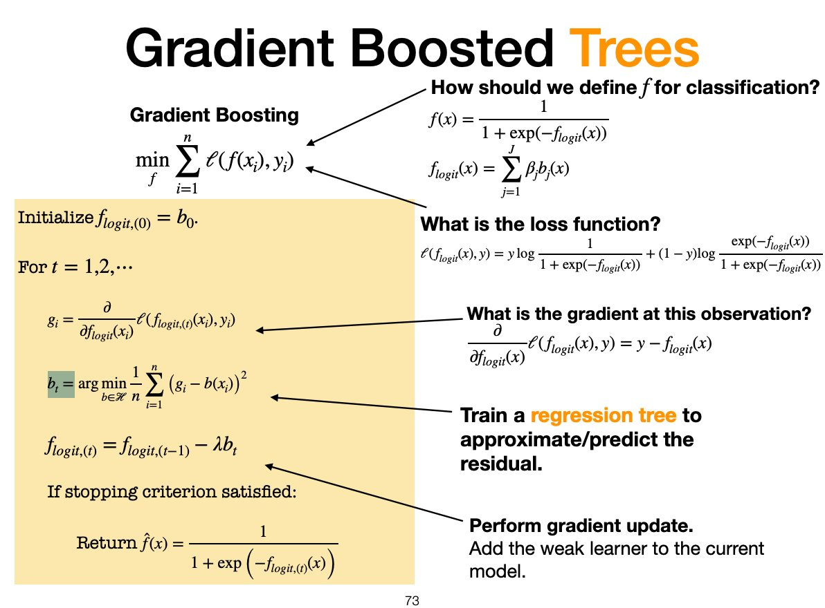
APPENDIX · FOR QUESTIONS
Gradient boosting, as covered in lecture
Rather than modeling the logit as a linear combination of features, gradient boosting models the logit as a sum of decision trees, with each new tree correcting the errors of the existing ensemble.
Cross entropy loss function
Source: DATASCI 224 Week 4 Lecture (gradient boosted trees). Notation: b = weak learner/tree, λ = learning rate; the residual y − f_logit is shorthand for y − p.
Notes:
Train a regression tree to approximate the pseudo-residuals (negative gradients) by finding, among all trees in the hypothesis class $𝓗$, the tree whose predictions $b_{t}\left(x_{i}\right)$are closest to the true gradients $g_{i}$in squared-error loss.
At each boosting iteration, we fit a regression tree to the current pseudo-residuals (negative gradients), choosing the tree whose predictions most closely match the gradients across the training data.
The gradient gives us a local estimate of how the loss would change if we altered the current model's predictions. By fitting a tree to the negative gradient, we create a weak learner that moves the model in the direction that most reduces the loss. Repeatedly adding these weak learners gradually improves the logit model until the gradients become very small, indicating that further changes to the predictions would produce little additional reduction in loss.
The original algorithm exactly as taught in lecture, kept so I can show the familiar version if asked. This is the lecture version. It is the same algorithm as my comparison slide; the lecture writes the trees as b and the learning rate as lambda, and writes the residual as y minus f_logit, which is shorthand for y minus the predicted probability p. My survival extension swaps the cross-entropy loss for the Cox partial likelihood, and the residual becomes the martingale residual, observed minus expected events. flogit is the log-odds function built as a weighted sum of t regression trees:
Here each gi is a regression tree (the "weak learner" at iteration i) and βi>0 is the corresponding learning rate coefficient.
The gradient boosted tree f(x) outputs a probability, specifically, the estimated probability Pr(Y=1∣X=x).

